Slide 1
Real-Time Systems
Specification and Analysis
ITV Real-Time Systems
Anders P. Ravn
Aalborg University
February 2006

Slide 2
Characteristics of a RTS
Timing Constraints
Dependability Requirements
Concurrent control of separate components
Facilities to interact with special purpose hardware

Slide 3
Real-Time Facilities
Topics
  Notion of time
  Clocks, delays and timeouts
  Specifying timing requirements
  Temporal scopes

Slide 4
Real-Time Facilities: Requirements
Interfacing with time
  measuring durations
  delaying processes until some future time
  programming timeouts so non-occurrence of some event can be recognized
Representing timing requirements
  specifying rates of execution
  specifying deadlines

Slide 5
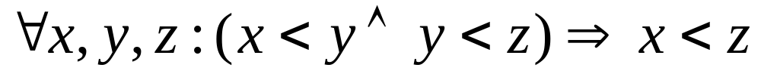
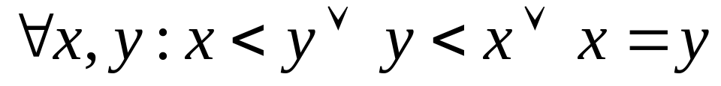
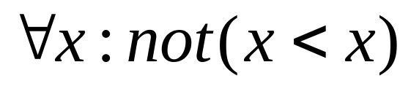
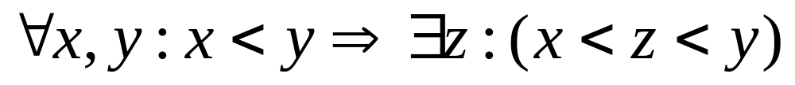
The Notion of Time
Transitivity:
Linearity:
Irreflexivity:
Density:

Slide 6
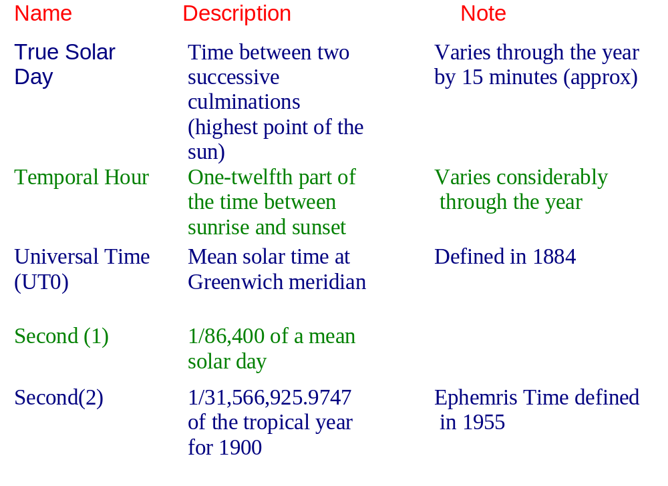
Standard Time

Slide 7
Name
Description
Note
UT1
correction to UTO because of
polar motion
UT 2
Correction of UT1 because of variation in the speed of rotation of the earth
Duration of 9_192_631_770 periods of the radiation corresponding to the
transition between two hyperfine levels of the ground state of the Caesium - 133 atom
Accuracy of current Caesium atomic clocks deemed to be one part of 10^13
(that is, one clock error per 300,000 years)
Seconds(3)
International Atomic Time (IAT)
Based upon Caesium atomic clock
Maximum difference between UT2 (which is based on astrological measurement) and IAT (which is based upon atomic measurements) is kept to below 0.5 seconds
Coordinated Universial Time (UTC)
An IAT clock synchronized to UT2 by the addition of occasional leap ticks

Slide 8
Access to a Clock
by having direct access to the environment's time frame, e.g. GPS also provides a UTC service.
by using an internal hardware clock that gives an adequate approximation to the passage of time in the environment

Slide 9
Clocks in Real-Time Java
java.lang.System.currentTimeMillis returns the number of milliseconds since 1/1/1970 GMT and is used by used by java.util.Date
Real-time Java adds real-time clocks with high resolution time types

Slide 10
RT Java Time Types
public abstract class HighResolutionTime implements
java.lang.Comparable
{
public abstract AbsoluteTime absolute(Clock clock,
AbsoluteTime destination);
...
public boolean equals(HighResolutionTime time);
public final long getMilliseconds();
public final int getNanoseconds();
public void set(HighResolutionTime time);
public void set(long millis);
public void set(long millis, int nanos);
}

Slide 11
public class AbsoluteTime extends HighResolutionTime
{
// various constructor methods including
public AbsoluteTime(AbsoluteTime T);
public AbsoluteTime(long millis, int nanos);
public AbsoluteTime absolute(Clock clock, AbsoluteTime dest);
public AbsoluteTime add(long millis, int nanos);
public final AbsoluteTime add(RelativeTime time);
...
public final RelativeTime subtract(AbsoluteTime time);
public final AbsoluteTime subtract(RelativeTime time);
}

Slide 12
public class RelativeTime extends HighResolutionTime
{
// various constructor methods including
public RelativeTime(long millis, int nanos);
public RelativeTime(RelativeTime time);
public AbsoluteTime absolute(Clock clock,
AbsoluteTime destination);
public RelativeTime add(long millis, int nanos);
public final RelativeTime add(RelativeTime time);
public void addInterarrivalTo(AbsoluteTime destination);
public final RelativeTime subtract(RelativeTime time);
...
}
public class RationalTime extends RelativeTime
{ . . .}

Slide 13
RT Java: Clock Class
public abstract class Clock
{
public Clock();
public static Clock getRealtimeClock();
public abstract RelativeTime getResolution();
public AbsoluteTime getTime();
public abstract void getTime(AbsoluteTime time);
public abstract void setResolution(RelativeTime resolution);
}

Slide 14
RT Java: Measuring Time
{
AbsoluteTime oldTime, newTime;
RelativeTime interval;
Clock clock = Clock.getRealtimeClock();
oldTime = clock.getTime();
// other computations
newTime = clock.getTime();
interval = newTime.subtract(oldTime);
}

Slide 15
Clocks in C and POSIX
ANSI C has a standard library for interfacing to “calendar” time
This defines a basic time type time_t and several routines for manipulating objects of type time
POSIX requires at least one clock of minimum resolution 50 Hz (20ms)

Slide 16
POSIX Real-Time Clocks
#define CLOCK_REALTIME ...; // clockid_t type
struct timespec {
time_t tv_sec; /* number of seconds */
long tv_nsec; /* number of nanoseconds */
};
typedef ... clockid_t;
int clock_gettime(clockid_t clock_id, struct timespec *tp);
int clock_settime(clockid_t clock_id, const struct timespec *tp);
int clock_getres(clockid_t clock_id, struct timespec *res);
int clock_getcpuclockid(pid_t pid, clockid_t *clock_id);
int clock_getcpuclockid(pthread_t thread_id, clockid_t *clock_id);
int nanosleep(const struct timespec *rqtp, struct timespec *rmtp);
/* nanosleep return -1 if the sleep is interrupted by a */
/* signal. In this case, rmtp has the remaining sleep time */

Slide 17
Delaying a Process
Start := Clock; -- from calendar
  loop
  exit when (Clock - Start) > 10.0;
  end loop;
To eliminate busy-waits, most languages and operating systems provide delay primitives:
In POSIX: sleep and nanosleep
Java: sleep;
RT Java has a high resolution sleep

Slide 18
Delays
Granularity difference between clock and delay
Time specified by program
Process executing
Process runnable here but not executable
Interrupts disabled
Time

Slide 19
Absolute Delays
  -- Ada
  START := Clock;
  FIRST_ACTION;
  delay 10.0 - (Clock - START);
  SECOND_ACTION;
Unfortunately, this might not achieve the desired result
  START := Clock;
  FIRST_ACTION;
  delay until START + 10.0;
  SECOND_ACTION;
As with delay, delay until is accurate only in its lower bound
RT Java - sleep can be relative or absolute
POSIX requires use of an absolute timer and signals

Slide 20
Drift
The time over-run associated with both relative and absolute delays is called the local drift and it it cannot be eliminated
It is possible, however, to eliminate the cumulative drift that could arise if local drifts were allowed to superimpose

Slide 21
Regular Activity
task T;
task body T is
begin
loop
Action;
delay 5.0;
end loop;
end T;
Cannot delay for less than
5 seconds
local and cumulative drift

Slide 22
Periodic Activity
task body T is
Interval : constant Duration := 5.0;
Next_Time : Time;
begin
Next_Time := Clock + Interval;
loop
Action;
delay until Next_Time;
Next_Time := Next_Time + Interval;
end loop;
end T;
Will run on average
every 5 seconds
local drift only
If Action takes 6 seconds, the delay
statement will have no effect

Slide 23
Timeouts in Real-Time Java
Timeouts are provided by a subclass of AsynchronouslyInterruptedException
called Timed
public class Timed extends AsynchronouslyInterruptedException
implements java.io.Serializable
{
public Timed(HighResolutionTime time) throws
IllegalArgumentException;
public boolean doInterruptible(Interruptible logic);
public void resetTime(HighResolutionTime time);
}

Slide 24
POSIX
POSIX does not support ATC and, therefore, it is difficult to get the same effect as Ada and RT Java
POSIX does support Timers (see later)

Slide 25
Temporal Scopes
deadline — the time by which the execution of a TS must be finished;
minimum delay — the minimum amount of time that must elapse before the start of execution of a TS;
maximum delay — the maximum amount of time that can elapse before the start of execution of a TS;
maximum execution time — of a TS;
maximum elapse time — of a TS.
Temporal scopes with combinations of these attributes are also possible

Slide 26
Now
Minimum delay
Maximum delay
a
Time
Maximum elapse time
b
c
Maximum execution time = a + b +c
Units of execution
Deadline

Slide 27
Temporal Scopes
Can be
  Periodic
  Sporadic
  Aperiodic
Deadlines can be:
  Hard
  Soft
  Interactive — performance issue
  Firm

Slide 28
POSIX: Periodic Thread
#include <signal.h>
#include <time.h>
#include <pthread.h>
void periodic_thread() /* destined to be the thread */
{
int signum; /* signal caught */
sigset_t set; /* signals to be waited for */
struct sigevent sig; /* signal information */
timer_t periodic_timer; /* timer for a periodic thread */
struct itimerspec required, old; /* timer details */
struct timespec first, period; /* start and repetition */
long Thread_Period = .... /* actual period in nanoseconds */

Slide 29
Real-Time Java
Objects which are to be scheduled must implement the Schedulable interface; objects must also specify their:
  memory requirements via the class MemoryParameters
  scheduling requirements via the class SchedulingParameters
  timing requirements via the class ReleaseParameters

Slide 30
Real-Time Java
public abstract class ReleaseParameters {
protected ReleaseParameters(RelativeTime cost,
RelativeTime deadline, AsyncEventHandler overrunHandler,
AsyncEventHandler missHandler);
public RelativeTime getCost();
public AsyncEventHandler getCostOverrunHandler();
public RelativeTime getDeadline();
public AsyncEventHandler getDeadlineMissHandler();
// methods for setting the above
}

Slide 31
Periodic Parameters
public class PeriodicParameters extends ReleaseParameters
{
public PeriodicParameters(
HighResolutionTime start,
RelativeTime period,
RelativeTime cost,
RelativeTime deadline,
AsyncEventHandler overrunHandler,
AsyncEventHandler missHandler);
public RelativeTime getPeriod();
public HighResolutionTime getStart();
public void setPeriod(RelativeTime period);
public void setStart(HighResolutionTime start);
}

Slide 32
Aperiodic and Sporadic Release Parameters
public class AperiodicParameters extends ReleaseParameters
{
public AperiodicParameters(RelativeTime cost,
RelativeTime deadline, AsyncEventHandler overrunHandler,
AsyncEventHandler missHandler);
}
public class SporadicParameters extends AperiodicParameters
{
public SporadicParameters(RelativeTime minInterarrival,
RelativeTime cost, RelativeTime deadline,
AsyncEventHandler overrunHandler,
AsyncEventHandler missHandler);
public RelativeTime getMinimumInterarrival();
public void setMinimumInterarrival(RelativeTime minimum);
}

Slide 33
Real-Time Threads
public class RealtimeThread extends java.lang.Thread
implements Schedulable
{
public RealtimeThread(SchedulingParameters s, ReleaseParameters r);
. . .
public static RealtimeThread currentRealtimeThread();
public synchronized void schedulePeriodic();
// add the thread to the list of schedulable objects
public synchronized void deschedulePeriodic();
// remove the thread from the list
// when it next issues a waitForNextPeriod
public boolean waitForNextPeriod() throws ...;
}

Slide 34
Summary
Time in a real-time programming language;
  access to a clock,
  delaying,
  timeouts,
  deadline specification and scheduling.
A temporal scope:
  deadline for completion of execution
  minimum delay before start of execution
  maximum delay before start of execution
  maximum execution time
  maximum elapse time

Slide 35
Scheduling
Goal
  To understand the role that scheduling and schedulability analysis plays in predicting that real-time applications meet their deadlines
Topics
  Simple process model
  The cyclic executive approach
  Process-based scheduling
  Utilization-based schedulability tests
  Response time analysis for FPS and EDF
  Worst-case execution time

Slide 36
Scheduling
In general, a scheduling scheme provides two features:
  An algorithm for ordering the use of system resources (in particular the CPUs)
  A means of predicting the worst-case behaviour of the system when the scheduling algorithm is applied

Slide 37
Simple Process Model
The application has a fixed set of processes
All processes are periodic, with known periods
The processes are independent of each other
All processes have deadline equal to their period
All processes have a worst-case execution time.
All context-switching costs etc. are ignored

Slide 38
Standard Notation
B
C
D
I
J
N
P
R
T
U
a-z
Worst-case blocking time for the process
Worst-case computation time (WCET)
Deadline of the process
The interference time of the process
Release jitter of the process
Number of processes in the system
Priority assigned to the process
Worst-case response time of the process
Minimum time between releases(process period)
The utilization of each process (equal to C/T)
The name of a process

Slide 39
Cyclic Executives
One common way of implementing hard real-time systems is to use a cyclic executive
Here the design is concurrent but the code is produced as a collection of procedures
Procedures are mapped onto a set of minor cycles that constitute the complete schedule (or major cycle)
Minor cycle dictates the minimum cycle time
Major cycle dictates the maximum cycle time
Has the advantage of being fully deterministic

Slide 40
Consider Process Set
Process Period,T Computation Time,C
a 25 10
b 25 8
c 50 5
d 50 4
e 100 2

Slide 41
Cyclic Executive
loop
wait_for_interrupt;
procedure_for_a; procedure_for_b; procedure_for_c;
wait_for_interrupt;
procedure_for_a; procedure_for_b; procedure_for_d;
procedure_for_e;
wait_for_interrupt;
procedure_for_a; procedure_for_b; procedure_for_c;
wait_for_interrupt;
procedure_for_a; procedure_for_b; procedure_for_d;
end loop;

Slide 42
Time-line for Process Set
Interrupt
Interrupt
Interrupt
Interrupt
a
b
c
a
b
d
e
a
b
c

Slide 43
Properties
No actual processes exist at run-time; each minor cycle is just a sequence of procedure calls
The procedures share a common address space and can thus pass data between themselves. This data does not need to be protected (via a semaphore, for example) because concurrent access is not possible
All “process” periods must be a multiple of the minor cycle time

Slide 44
Problems with Cycle Executives
The difficulty of incorporating processes with long periods; the major cycle time is the maximum period that can be accommodated without secondary schedules
Sporadic activities are difficult (impossible!) to incorporate
The cyclic executive is difficult to construct and difficult to maintain — it is a NP-hard problem
Any “process” with a sizable computation time will need to be split into a fixed number of fixed sized procedures (this may cut across the structure of the code from a software engineering perspective, and hence may be error-prone)
More flexible scheduling methods are difficult to support
Determinism is not required, but predictability is

Slide 45
Process-Based Scheduling
Scheduling approaches
  Fixed-Priority Scheduling (FPS)
  Earliest Deadline First (EDF)
  Value-Based Scheduling (VBS)

Slide 46
Fixed-Priority Scheduling (FPS)
This is the most widely used approach and is the main focus of this course
Each process has a fixed, static, priority which is computer pre-run-time
The runnable processes are executed in the order determined by their priority
In real-time systems, the “priority” of a process is derived from its temporal requirements, not its importance to the correct functioning of the system or its integrity

Slide 47
Earliest Deadline First (EDF) Scheduling
The runnable processes are executed in the order determined by the absolute deadlines of the processes
The next process to run being the one with the shortest (nearest) deadline
Although it is usual to know the relative deadlines of each process (e.g. 25ms after release), the absolute deadlines are computed at run time and hence the scheme is described as dynamic

Slide 48
Value-Based Scheduling (VBS)
If a system can become overloaded then the use of simple static priorities or deadlines is not sufficient; a more adaptive scheme is needed
This often takes the form of assigning a value to each process and employing an on-line value-based scheduling algorithm to decide which process to run next

Slide 49
Preemption and Non-preemption
With priority-based scheduling, a high-priority process may be released during the execution of a lower priority one
In a preemptive scheme, there will be an immediate switch to the higher-priority process
With non-preemption, the lower-priority process will be allowed to complete before the other executes
Preemptive schemes enable higher-priority processes to be more reactive, and hence they are preferred
Alternative strategies allow a lower priority process to continue to execute for a bounded time
These schemes are known as deferred preemption or cooperative dispatching
Schemes such as EDF and VBS can also take on a pre-emptive or non pre-emptive form

Slide 50

FPS and Rate Monotonic Priority Assignment
Each process is assigned a (unique) priority based on its period; the shorter the period, the higher the priority
I.e, for two processes i and j,
This assignment is optimal in the sense that if any process set can be scheduled (using pre-emptive priority-based scheduling) with a fixed-priority assignment scheme, then the given process set can also be scheduled with a rate monotonic assignment scheme
Note, priority 1 is the lowest (least) priority

Slide 51
Example Priority Assignment
Process Period, T Priority, P
a 25 5
b 60 3
c 42 4
d 105 1
e 75 2

Slide 52
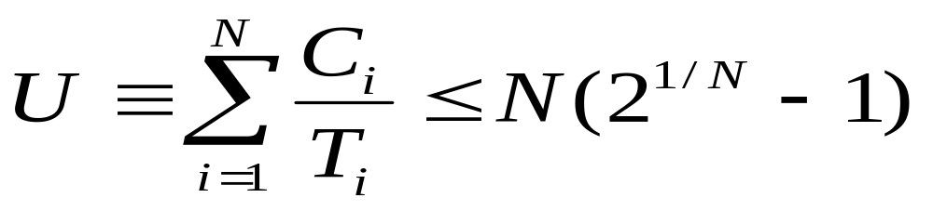

Utilisation-Based Analysis
For D=T task sets only a simple sufficient but not necessary schedulability test exists

Slide 53
Utilization Bounds
N Utilization bound
1 100.0%
2 82.8%
3 78.0%
4 75.7%
5 74.3%
10 71.8%
Approaches 69.3% asymptotically

Slide 54
Process Set A
Process Period ComputationTime Priority Utilization
T C P U
a 50 12 1 0.24
b 40 10 2 0.25
c 30 10 3 0.33
The combined utilization is 0.82 (or 82%)
This is above the threshold for three processes (0.78) and, hence, this process set fails the utilization test

Slide 55
Time-line for Process Set A
Process
a
Process Release Time
Process Completion Time
Deadline Met
b
Process Completion Time
Deadline Missed
Preempted
c
Executing
0
10
20
30
40
50
60
Time

Slide 56
Gantt Chart for Process Set A
c
b
a
c
b
0
10
20
30
40
50
Time

Slide 57
Process Set B
Process Period ComputationTime Priority Utilization
T C P U
a 80 32 1 0.400
b 40 5 2 0.125
c 16 4 3 0.250
The combined utilization is 0.775
This is below the threshold for three processes (0.78) and, hence, this process set will meet all its deadlines

Slide 58
Process Set C
Process Period ComputationTime Priority Utilization
T C P U
a 80 40 1 0.50
b 40 10 2 0.25
c 20 5 3 0.25
The combined utilization is 1.0
This is above the threshold for three processes (0.78) but the process set will meet all its deadlines

Slide 59
Time-line for Process Set C
Process
a
b
c
0
10
20
30
40
50
60
70
80
Time

Slide 60
Criticism of Utilisation-based Tests
Not exact
Not general
BUT it is O(N)
The test is said to be sufficient but not necessary

Slide 61
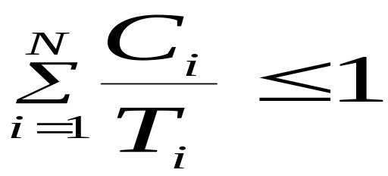
Utilization-based Test for EDF
A much simpler test
Superior to FPS; it can support high utilizations. However
FPS is easier to implement as priorities are static
EDF is dynamic and requires a more complex run-time system which will have higher overhead
It is easier to incorporate processes without deadlines into FPS; giving a process an arbitrary deadline is more artificial
It is easier to incorporate other factors into the notion of priority than it is into the notion of deadline
During overload situations
  FPS is more predictable; Low priority process miss their deadlines first
  EDF is unpredictable; a domino effect can occur in which a large number of processes miss deadlines

Slide 62
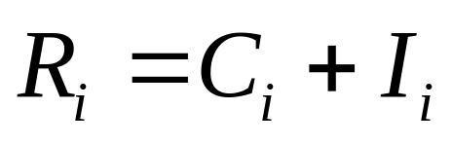
Response-Time Analysis
Here task i's worst-case response time, R, is calculated first and then checked (trivially) with its deadline
R ≤ D
i
i
Where I is the interference from higher priority tasks

Slide 63
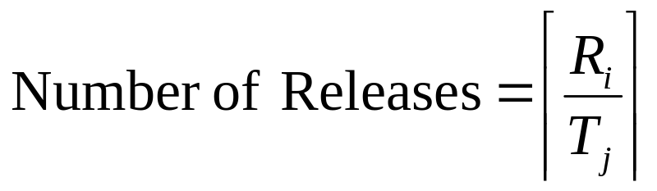

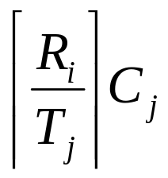
Calculating R
During R, each higher priority task j will execute a number of times:
The ceiling function gives the smallest integer greater than the fractional number on which it acts. So the ceiling of 1/3 is 1, of 6/5 is 2, and of 6/3 is 2.
Total interference is given by:

Slide 64
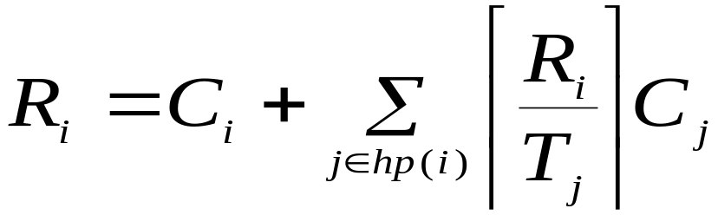
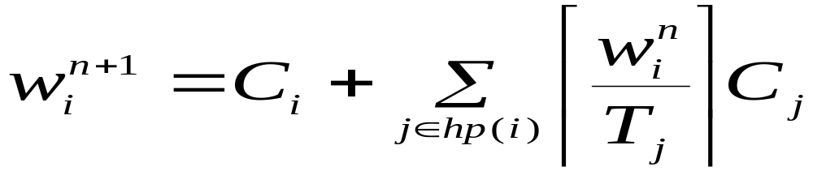





Response Time Equation
Where hp(i) is the set of tasks with priority higher than task i
Solve by forming a recurrence relationship:
The set of values is monotonically non decreasing
When the solution to the equation has been found,
must not be greater that (e.g. 0 or )

Slide 65
Revisit: Process Set C
Process Period ComputationTime Priority Response time
T C P R
a 80 40 1 80
b 40 10 2 15
c 20 5 3 5
The combined utilization is 1.0
This was above the utilization threshold for three processes (0.78), therefore it failed the test
The response time analysis shows that the process set will meet all its deadlines
RTA is necessary and sufficient

Slide 66
Response Time Analysis
Is sufficient and necessary
If the process set passes the test they will meet all their deadlines; if they fail the test then, at run-time, a process will miss its deadline (unless the computation time estimations themselves turn out to be pessimistic)

Slide 67
Worst-Case Execution Time - WCET
Obtained by either measurement or analysis
The problem with measurement is that it is difficult to be sure when the worst case has been observed
The drawback of analysis is that an effective model of the processor (including caches, pipelines, memory wait states and so on) must be available

